Slide 1
Teaching a computer to play video games
The bridge between neuroscience and computer science
Presentation by: Magdalyn Elkin
Notes:
Hello and welcome to my slide deck! Please read the slides in presentation mode to be able to view the videos. ☺

Slide 2
Space Invaders
Space invaders is a classic arcade game where the player shoots upward at aliens moving right and down
Points are earned by shooting the alien ships
Clip from Futurama, Season 4, Episode 3
https://youtu.be/oOCxEV8BD8o

Slide 3
DeepMind
DeepMind was a small company acquired by Google in 2014
They created a program that could teach itself how to play Space Invaders
The only inputs were the pixels on the screen and the current score.
The program was able to play a flawless space invaders game with no hand-tuning whatsoever
The same program also learned how to play all 49 Atari games
All the program needed was time to practice each game
https://gph.is/1dujiqi
Notes:
https://gph.is/1dujiqi

Slide 4
How was the program able to teach itself how to play an Atari game?
Reinforcement Learning
A field of artificial Intelligence in which a computer program learns from experience

Slide 5
Reinforcement Learning
The goal is to train the dog to complete a task in the environment
The environment includes the surroundings of the dog as well as the trainer
The trainer issues a command which the dog observes and then responds by taking an action which rewarded by a treat
In the case of the image to the right, the trainer would throw the stick, the dog would retrieve the stick and return to the trainer and receive a treat
https://www.kdnuggets.com/2019/10/mathworks-reinforcement-learning.html

Slide 6
Wait, I thought we were talking about computers…

Slide 7
Reinforcement Learning
It’s the same thing as training your dog!
The agent interacts with their environment which is comprised of several states
Each state has a corresponding action with a corresponding reward
The agent learns the action and state values and acts to maximize rewards
https://lilianweng.github.io/lil-log/2018/02/19/a-long-peek-into-reinforcement-learning.html

Slide 8
Reinforcement Learning in Atari
The environment is the Atari Emulator
The agent plays as the spaceship
The actions are move joystick left or right or press the “fire” button
States are the agent’s representation of the environment
The reward is the cumulative points earned
https://www.youtube.com/watch?v=Pf_0IT5OjiI

Slide 9
Prediction and Control
For DeepMind’s program to learn how to play Atari it needed algorithms for prediction and control
Prediction algorithms learn the value for the state and action
Control algorithms guide the agent towards selecting the action for each state that will in turn maximize the rewards

Slide 10
The psychology behind reinforcement learning
Operant Conditioning
(Control)
Classical Conditioning
(Prediction)

Slide 11
Classical Conditioning
Classical Conditioning was found on accident!
A Russian physiologist, Ivan Pavlov was studying salivation in dogs in response to being fed
He realized that whenever the dogs heard the assistant coming near with the food the dogs started to salivate; even before they saw the food.
This was the beginning of Classical Conditioning
https://www.commonsenseevaluation.com/2013/07/15/cartoon-of-the-day-pavlovs-dog/

Slide 12
Classical Conditioning
The pairing of two stimuli give a response
The bell is the conditioned stimulus
The food is the unconditioned stimulus
The response (salivation) can be thought of as a prediction of the unconditioned stimulus arrival
Bell
Food
Salivation

Slide 13
Classical Conditioning
Reinforcement learning prediction algorithms are equivalent to classical conditioning
They both include predicting upcoming stimuli
In the case of reinforcement learning the upcoming stimuli is the reward for an action in a given state
In the classical conditioning example video shown here, the stimuli is the computer sound and the prediction is a mint will be received
The Office, Season 3, Episode 15
https://youtu.be/lwwCkXz-gD0

Slide 14
Operant Conditioning
B.F. Skinner is considered the father of Operant Conditioning
His work was based on Thorndike's law of effect
Skinner expanded the law of effect to introduce positive/negative reinforcements
This was classically shown in the “Skinner Box”
Rats would learn to press a lever in response to a light turning on to receive food

Slide 15
Operant Conditioning
Operant Conditioning
Positive Reinforcement
Negative Reinforcement
Punishment
Behaviors that are positively rewarded are strengthened
Behaviors that remove an adverse stimulus are strengthened
Behaviors that introduce an adverse stimulus are weakened
Thorndike's law of effect
Behavior that is followed by pleasant consequences is likely to repeated
Behavior that is followed by unpleasant consequences is less likely to be repeated

Slide 16
Operant Conditioning
Reinforcement learning Control Algorithms are equivalent to operant conditioning in psychology
Here the agent is the rat, the environment is the cage and the trainer, the action is to take the ball and place it through the hoop to receive a reward (a treat!)
https://youtu.be/drnnulHw5CM
Notes:
https://youtu.be/drnnulHw5CM

Slide 17
So DeepMind’s program is the same as a dog?
Well almost, but not quite
Dogs live in the real world where they have sensory perceptions of their environment
The agent lives in a stimulated, virtual world
The agent must perceive its world by looking at the pixels on the screen

Slide 18
How does the Agent view the Atari world?
The environment is the Atari Emulator
A program that mimics the behavior of an Atari console
The environment pulls information from the games computer memory
The agent’s internal state is observed from an image
A vector of raw pixel values representing the current screen
The agent isn’t told “There’s a monster shooting at you at this position and moving in this direction and your spaceship is here and moving left”
The agent is given an image and the agent must figure out by itself where the monster is
By using the environment, the program can look up the inputs and present the pixels and current score as sensory input to the agent
Then the agents commands to the environment is interpreted as joystick actions

Slide 19
Agent State in Atari
When training a dog to fetch a stick, his state is the sensory input of the world around him and the observation of the trainer about to throw the stick
The agent’s state is the pixel inputs to the screen and his current score
But the Atari screen itself doesn’t change that much from frame to frame
Also the movement of a joystick takes several milliseconds to move the spaceship
The agent’s state instead is a sequence of consecutive frames and the same action between them
This satisfies the conditions in a Markov Decision Process (MDP)
https://danieltakeshi.github.io/2016/11/25/frame-skipping-and-preprocessing-for-deep-q-networks-on-atari-2600-games/

Slide 20
Markov Decision Process
A MDP is where an agent interacts with his environment at discrete time steps
Agent observes state at step t (S_{t})
Produces action at step t (A_{t})
Gets resulting reward (R_{t+1})
And resulting next state(S_{t+1})
R. S. Sutton and A. G. Barto: Reinforcement Learning: An Introduction

Slide 21
Prediction in Reinforcement Learning vs Classical Conditioning
Reinforcement Learning
Classical Conditioning
Association between state and action
Specific state-action pair gives a specific reward response
Agent predicts the reward for each state
Called a q-function
Thought as the “quality” of the action in that state
Prediction is necessary to guide future actions
Association between two stimuli
Conditioned Stimulus and Unconditioned Stimulus
The Unconditioned Stimulus produces a specific response
After repeated pairings, the conditioned stimulus produces the response
Response is prediction that the unconditioned stimulus will occur

Slide 22
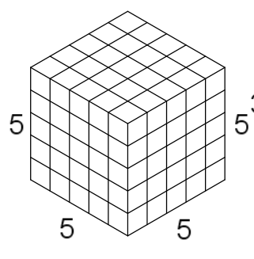
Prediction: How to associate state and action?
The picture to the right is a visual interpretation of the agent’s memory.
Each state is represented in a cell as well as each action the agent can take from that state.
After each action is taken, the state cell will hold the maximum total future reward possible if you take that action
State
Action

Slide 23
Future reward?
Future reward is the key assumption here. As sometimes simply moving to the left will not get the agent’s space ship any reward (immediately)
The same can be seen with the dog. Only returning the stick to the trainer will get the actual reward. But the dog knows it has to take steps towards the stick, pick it up and return it to the trainer

Slide 24
Q Value
Action Value Estimates Q(s,a)
Q Value is a measure of overall expected reward assuming agent is in state s and performs action a and then continues playing until the end of the episode following some policy.
Predicted reward
The q-value of action 1 is the “quality” of that state, the total discounted future reward expected taking action 1 from state 1

Slide 25
Q Value
For an example, take the agent in the left
Reaching the beer gets 100 points
(bedroom, left) -> (hallway, down) -> (stairwell, right) are the state action pairs to receive reward 100
There is no immediate reward for (bedroom, left)
However the Q(s,a) value can be calculated using a discounted sum of total future rewards
Say 12.5 (depending on the discounted factor)
https://kunuk.wordpress.com/2012/01/14/q-learning-library-example-with-csharp/

Slide 26
Q Learning
Initially the agent will randomly choose state-action pairs
The agent learns the state-action rewards with each state-action pair
Then the q-value is updated to reflect what the agent has learned during the game
Eventually through random movements the agent will predict that (bedroom, left) is the correct initial action
Assuming that there is also (bedroom, right) of course
https://kunuk.wordpress.com/2012/01/14/q-learning-library-example-with-csharp/

Slide 27
Control in Reinforcement learning vs Operant Conditioning
Reinforcement Learning
Operant Conditioning
Agent learns a policy
Policy is taking a defined steps of movements to reach the future reward
Agent aims to produce the actions in the optimal policy
The policy that will maximize future rewards
Behavior gets response
Behavior is either reinforced or weakened

Slide 28
Control: how to maximize rewards?
After the agent learns all Q(s,a) values, control is defined as instructing the agent to take the best policy
How do we learn the best policy?
Do we act in such a way that we believe will maximize rewards every time (acting greedy)
Do we explore the environment and find new ways to maximize rewards
State
Action

Slide 29
Policy and Control
After experience, and prediction values, the agent then aims to follow the actions with the highest q-values, while still exploring
The agent follows an off-policy strategy
Doesn’t always follow the highest q-value (acting greedy)
If agent acted greedy the whole game, then it would miss out on learning new values for different state-action pairs
While the agent playing space invaders uses the highest predicted q values to guide his actions most of the time, there is a small probability to choose a random action
Choosing random actions will increase the state-action experiences to have a more accurate prediction of other state-actions

Slide 30
How to beat Atari Games
But wait a second, the agent has to learn every single Q(s,a) value to get a flawless game?
That would take years!
There’s also Trillion of states in a game like Space Invaders.
How could DeepMind possibly learn and store values for each state and the four actions that could take place in each state
DeepMind uses a neural network to approximate Q functions to approximate the action-value cube
At the same time you can train the q-function with experience from playing Space Invaders
If you have ever played space invaders, you know that it does take years to finally play a flawless game.
Even Fry in Futurama (from the first slide) took years of playing space invaders to beat the invaders from space.

Slide 31
Approximate q-functions
Instead of storing each Q(s,a), we can use a function to approximate the value
Thus we don’t have to store the trillion of state-action pairs associated with Atari
The form needs to flexible enough to approximate correctly
Also it needs to be trainable to update the approximate values with experience learned
We can do this with a neural network to help predict the best moves
Then with experience we tweak the neural network by adjusting the weights
This leads to better prediction which leads to more accurate information on how to control movements (i.e. which action should be taken to maximize reward)

Slide 32
Neural Networks
A neural network is a mathematical function inspired by biological neurons
Data points are fed as inputs to the neural network
They converge in hidden layers which then classify the data points as output
The example on the right shows a neural network that is trained to classify an image as a dog as “dog” and an image as a cat as “cat”
https://towardsai.net/p/machine-learning/what-is-machine-learning-how-does-it-work-and-why-is-it-important/robiriondo/3339/

Slide 33
The Artificial Neuron
A neural network consists of artificial neurons
Each one has inputs and weights that combine together as a summing function
If their combination is higher than a certain threshold then a specified output is produced
The training period learns the appropriate weights to input
https://medium.com/@jayeshbahire/the-artificial-neural-networks-handbook-part-4-d2087d1f583e

Slide 34
Neurons in your brain
Artificial neurons are structurally based on biological neurons
Each neuron has dendrites that connect to other neurons
Chemical signals (inputs) from other neurons combine at the soma (summing function)
If the signals are above a certain threshold, the soma sends chemical signals down the axon to axon terminals to send signals to other neurons (output response)
https://www.neuroskills.com/brain-injury/neuroplasticity/neuronal-firing/

Slide 35
Artifical Neurons combined
When these artificial neurons combine into hidden layers, the neural network is able to learn more complicated relationships between features to produce accurate outputs
Neural networks consist of many different artificial neurons combined
Each hidden layer has inputs coming from the previous layer and outputs to the next layer
Training a neural network adjusts weights for each layers input
https://physics.aps.org/articles/v13/2

Slide 36
Neural Systems
The combination of artificial neural networks gives something similar to the nervous system in your brain and body
The combination of neurons leads to processing information
The combination of artificial neurons leads to classification or approximation of the relevant data points
https://gph.is/2b7kHKd

Slide 37
DeepMind Neural Network Structure
Set the input neurons to match the colors of pixels in an image
Pixels are in RGB values
Inputs go through a convolutional neural network (CNN) layer
CNN acts as a filter to scan the image and produce a reduced dimensional space
Ultimately this transforms raw pixels on screen into useful features
Input features from CNN layer are fed into a fully connected neural network that will produce the output response
Output is the value function of that state for a given joystick action
The neural network structure for DeepMind was adaptive enough to learn all Atari games (not just space invaders)
The main difference between the games would be the number of output neurons which correspond to the actions allowed by the game
Human-level control through deep reinforcement learning. Nature 518, 529–533

Slide 38
Training the neural network
Scores from different Atari games vary greatly, so all positive rewards were fixed to 1 and negative rewards to -1 and 0 indicating no reward change
The q-value isn’t stored in a giant “cube” of memory
Instead it’s stored in the neural network memory the Q-network
State and output q-value are associated with each other through the artificial neurons
Using an appropriate evaluation metric, the weights between the input state neurons to the output Q-value neurons are updated
Thus the association between state and action are done in the neural network weights which are calculating the Q-values
This is called DQN and the simplified structure is shown in the image to the right
https://www.quora.com/In-deep-Q-learning-how-we-update-the-weight-in-neural-network

Slide 39
Neurons in Classical Conditioning
In classical conditioning you have two stimuli occurring at the same time, a conditioned and unconditioned stimulus
In the image to the right, the tone is the conditioned stimulus and the foot shock is the unconditioned stimulus
Sensory neurons firing in response to the two stimuli converge in one area
The convergence leads to output neurons producing a response
In this case fear
Initially, the tone alone will not produce the output response
After repeated pairings, the output neurons will produce the response to the tone alone
This association is learned by neuronal plasticity
https://www.researchgate.net/figure/Neural-circuits-engaged-during-fear-conditioningDuring-fear-conditioning-the_fig3_11523425

Slide 40
Neuronal Plasticity
Neuronal Plasticity is the brains way to modify itself in response to experience
The brain “re-wires” itself based on differing inputs
This can be done in a number of ways, but a common one is by increasing the base amount of chemicals that can be sent to or received from one neuron to another
Remember that neurons accumulate signals from other neurons in the dendrites and fire if the accumulated signals reach a certain threshold
To increase the strength between two neurons structural changes can happen on either side that increase the chemical signals that can be given and received
This can be thought as increasing the weights between the input neuron and the output neuron
Neuron interactions can also be weakened, where structural changes occur that decrease chemical signals that are given or received
Decreasing the weights between the input neuron and the output neuron
https://learnmuscles.com/blog/2017/08/30/neural-plasticity/

Slide 41
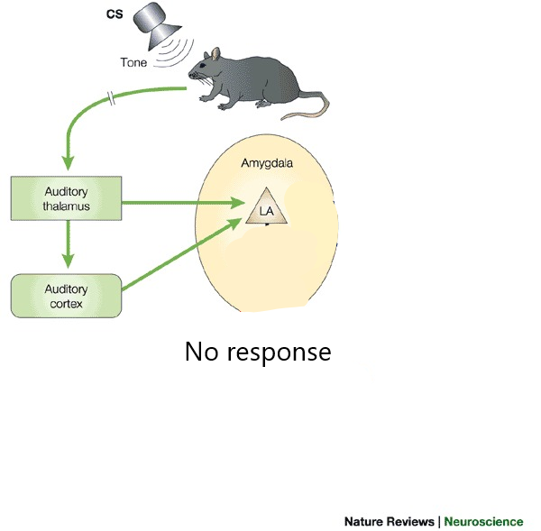
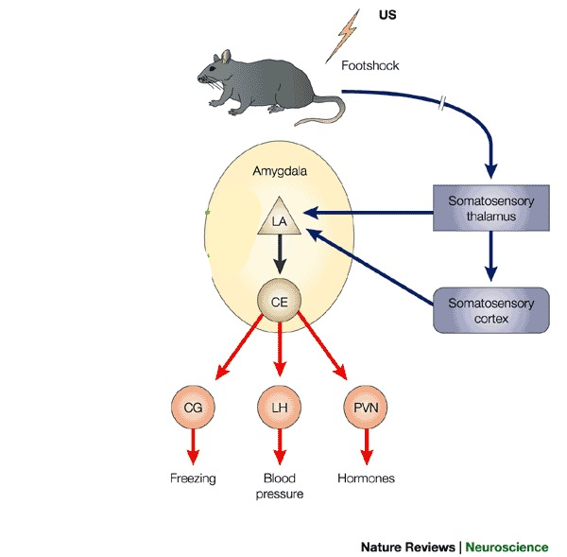
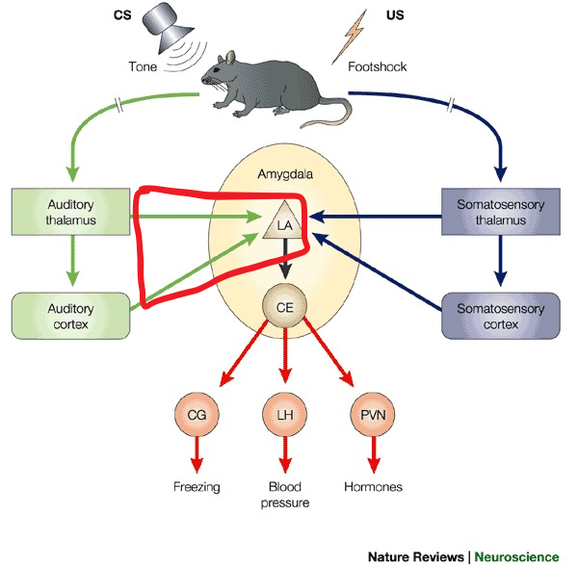
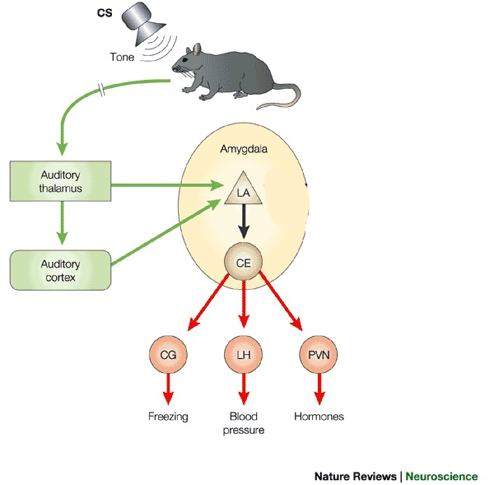
Neuronal Plasticity: a simplified example
Initially with the tone alone there is no response.
The foot shock will activate neurons to produce a response.
Foot shock and tone are repeatedly paired together
After learning, the tone alone will produce the response
The audio neurons have a neutral response because the neurons have a weak relationship and the audio neurons input doesn’t reach a certain threshold
The foot shock neurons have a strong activation and the output neurons reach the threshold to produce the response
Through timely repeated pairings the audio neurons and output neurons are strengthened. The “weight” of the neurons are adjusted
This is how the animal will learns the association of the tone and the foot-shock. The response to the tone is the animal predicting a foot-shock and producing the appropriate response.

Slide 42
Neuron weights vs Neuronal Plasticity
Reinforcement Learning
Classical Conditioning
State input neurons reach action output neurons
Output is the estimated action value (q-value)
Association between state and action value pair is learned by the weights between neurons in the DQN network
Adjusting the weight numeric value leads to better prediction of the q-value
Neurons from different sensory areas converge together in one section
Their timely paired arrival activate output neurons
The continual activation strengthen the relationship of the conditioned stimuli neuronal input and the output neurons which eventually fire
Strengthening is through neuronal plasticity
Adjusting the weights of the neurons
This leads to the predicted output response

Slide 43
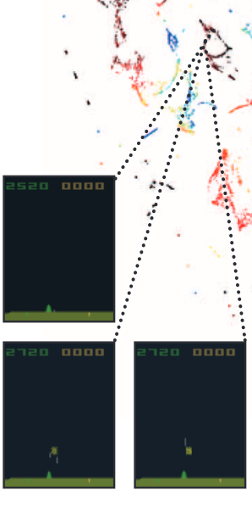
Invaders! Possibly from Space!
Summary
The agent interacts with the environment in a series of states and takes a series of actions which produces reward
The agent chooses actions based on the Q(s,a) values
Q(s,a) values are learned via a DQN which inputs the states and uses weights to calculate q-value for each possible action
The agent chooses the action with the highest q-value acting greedily (most times) while still sometimes breaking out of the policy to explore other actions
This will properly update the weights to get a better approximation of all q-values
With experience the agents estimated q-values will converge to represent the actual q-values
Then you have an agent who can play a perfect game!
The images to the right are taken from a embedded representation in the last hidden layer assign by DQN to game states
The one on the left shows state-action pairs that have low q-values
Presumably because there are few aliens to shoot down and the last alien is getting very close to the bottom
The image on the right shows state-action pairs with high q-values
The agent has many ships to shoot down and isn’t close to being shot himself
Human-level control through deep reinforcement learning. Nature 518, 529–533

Slide 44
How Computer Science Meets Neuroscience
Reinforcement Learning
Neuroscience
Agents learn to predict action-state values
Agents act in a way to maximize rewards and minimize punishments
DQN networks learn associations by adjusting weights
Prediction in Classical Conditioning
Behavioral consequences in Operant Conditioning
Associations learned by strengthening neurons

Slide 45
So why bother comparing neuroscience to computer science?
The field of artificial intelligence is dedicated to creating agents/computers/programs that can think like humans do
Many aspects of computer science/machine learning have been inspired by neuroscience
Understanding both neuroscience and computer science has benefits to advance both fields
https://www.eecs.mit.edu/news-events/announcements/two-departments-team-study-human-and-artificial-intelligence

Slide 46
Reinforcement Learning and AI
Creating an AI that can exhibit intelligent behavior equivalent to that of a human has been a long standing goal in the field
As tested by the Turing Test
DeepMind was initially so impressive because it had the ability to teach itself how to play Space Invaders
It was able to do this using behaviorist approaches
Other programs that have been successful using reinforcement learning are AlphaGo and Alpha Zero
AlphaGo beat the world champion in Go and AlphaZero can play chess, shogi and Go
Do reinforcement learning agents demonstrate true artificial intelligence?
It was able to learn (intelligence) by itself (artificial)!
However Reinforcement Learning researchers acknowledge that the agent has no true awareness of what it is actually doing
And the agent has limitations to the specific constraints that it was given (they have little autonomy)

Slide 47
Conclusion
Reinforcement Learning is a way to train an AI on how to accomplish sequential decision making tasks
Deep learning is a way to learn representations
The combinations of these two create agents that can teach itself how to play games
Both of these fields have roots in psychology and neuroscience
Combining these fields can help create truly impressive artificial intelligent beings
https://gph.is/2uHFc4G

Slide 48
References
Gerrish, Sean. How Smart Machines Think. The MIT Press, 2019
Mcleod, Saul. “Pavlov's Dogs.” Pavlov's Dogs Study and Pavlovian Conditioning Explained | Simply Psychology, Simply Psychology, 8 Oct. 2018, www.simplypsychology.org/pavlov.html.
Mcleod, Saul. “Skinner - Operant Conditioning.” B.F. Skinner | Operant Conditioning | Simply Psychology, www.simplypsychology.org/operant-conditioning.html.
Mnih, Volodymyr & Kavukcuoglu, Koray & Silver, David & Graves, Alex & Antonoglou, Ioannis & Wierstra, Daan & Riedmiller, Martin. (2013). Playing Atari with Deep Reinforcement Learning.
Mnih, V., Kavukcuoglu, K., Silver, D. et al. Human-level control through deep reinforcement learning. Nature 518, 529–533 (2015). https://doi.org/10.1038/nature14236
R. S. Sutton and A. G. Barto,Reinforcement Learning, An Introduction. Second Edition.The MIT Press, 2018
von Bernhardi R., Bernhardi L.E., Eugenín J. (2017) What Is Neural Plasticity?. In: von Bernhardi R., Eugenín J., Muller K. (eds) The Plastic Brain. Advances in Experimental Medicine and Biology, vol 1015. Springer, Cham

