Slide 1
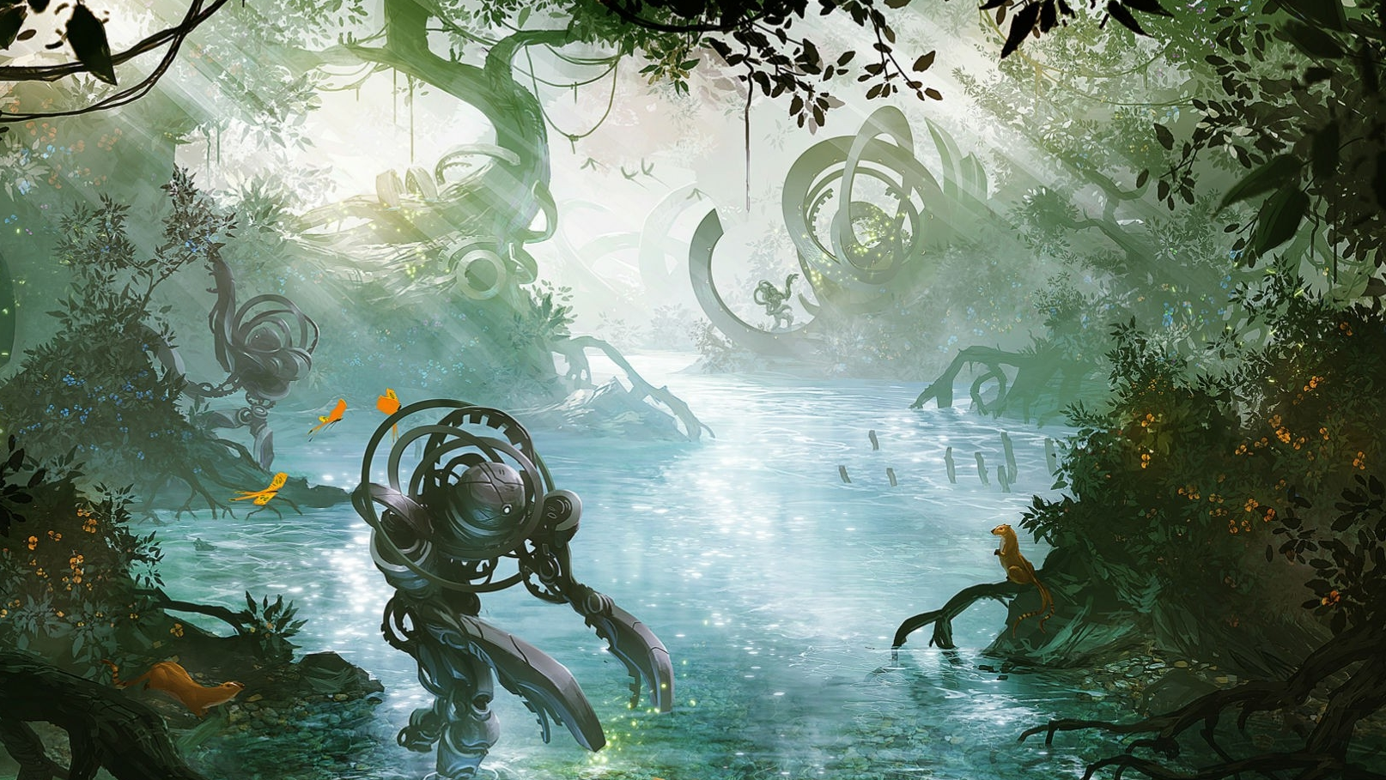
History of Automata and robots
By Ryan Harper

Slide 2
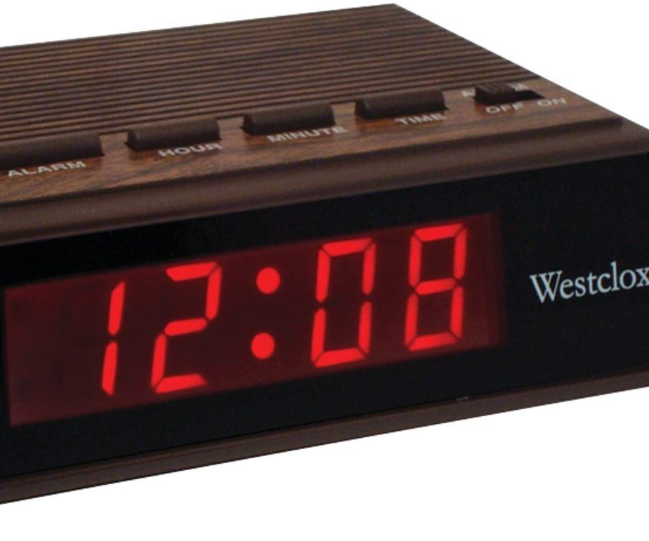
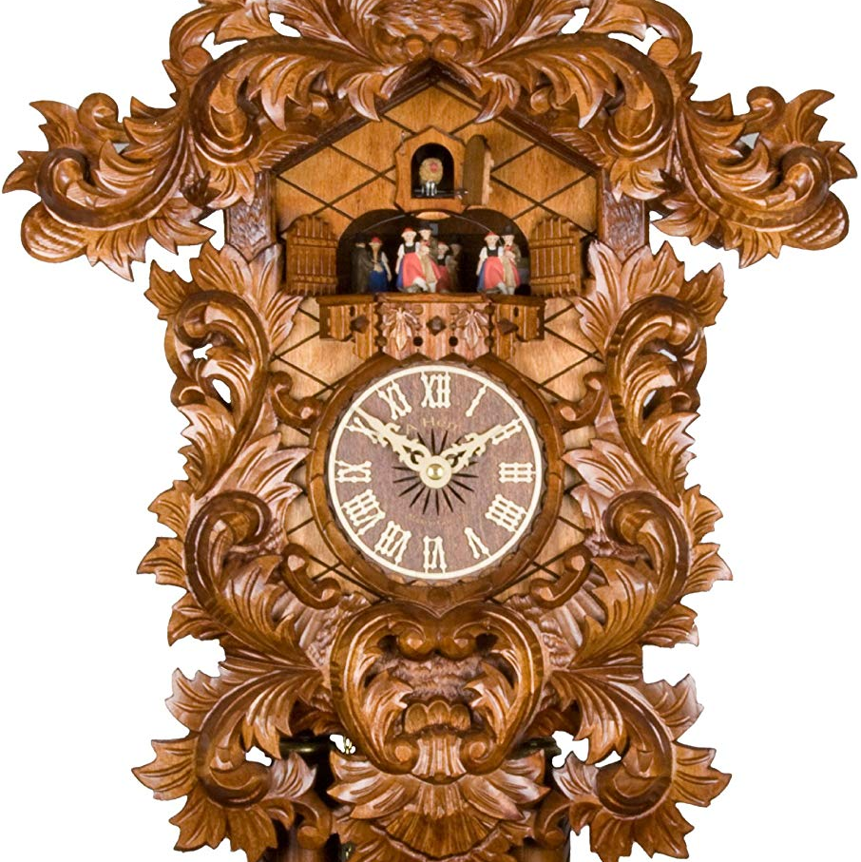
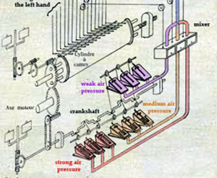
Inspiration
In Gerrish’s book, one of the first concepts he mentioned was how the automata of yesterday influenced the robots and autonomous systems of today
He explained how the Vauncanson Flute Player worked and functioned and I was fascinated that such things were possible back then
When I did more digging, I discovered even more fascinating automata, even so far back as ancient Greece!

Slide 3
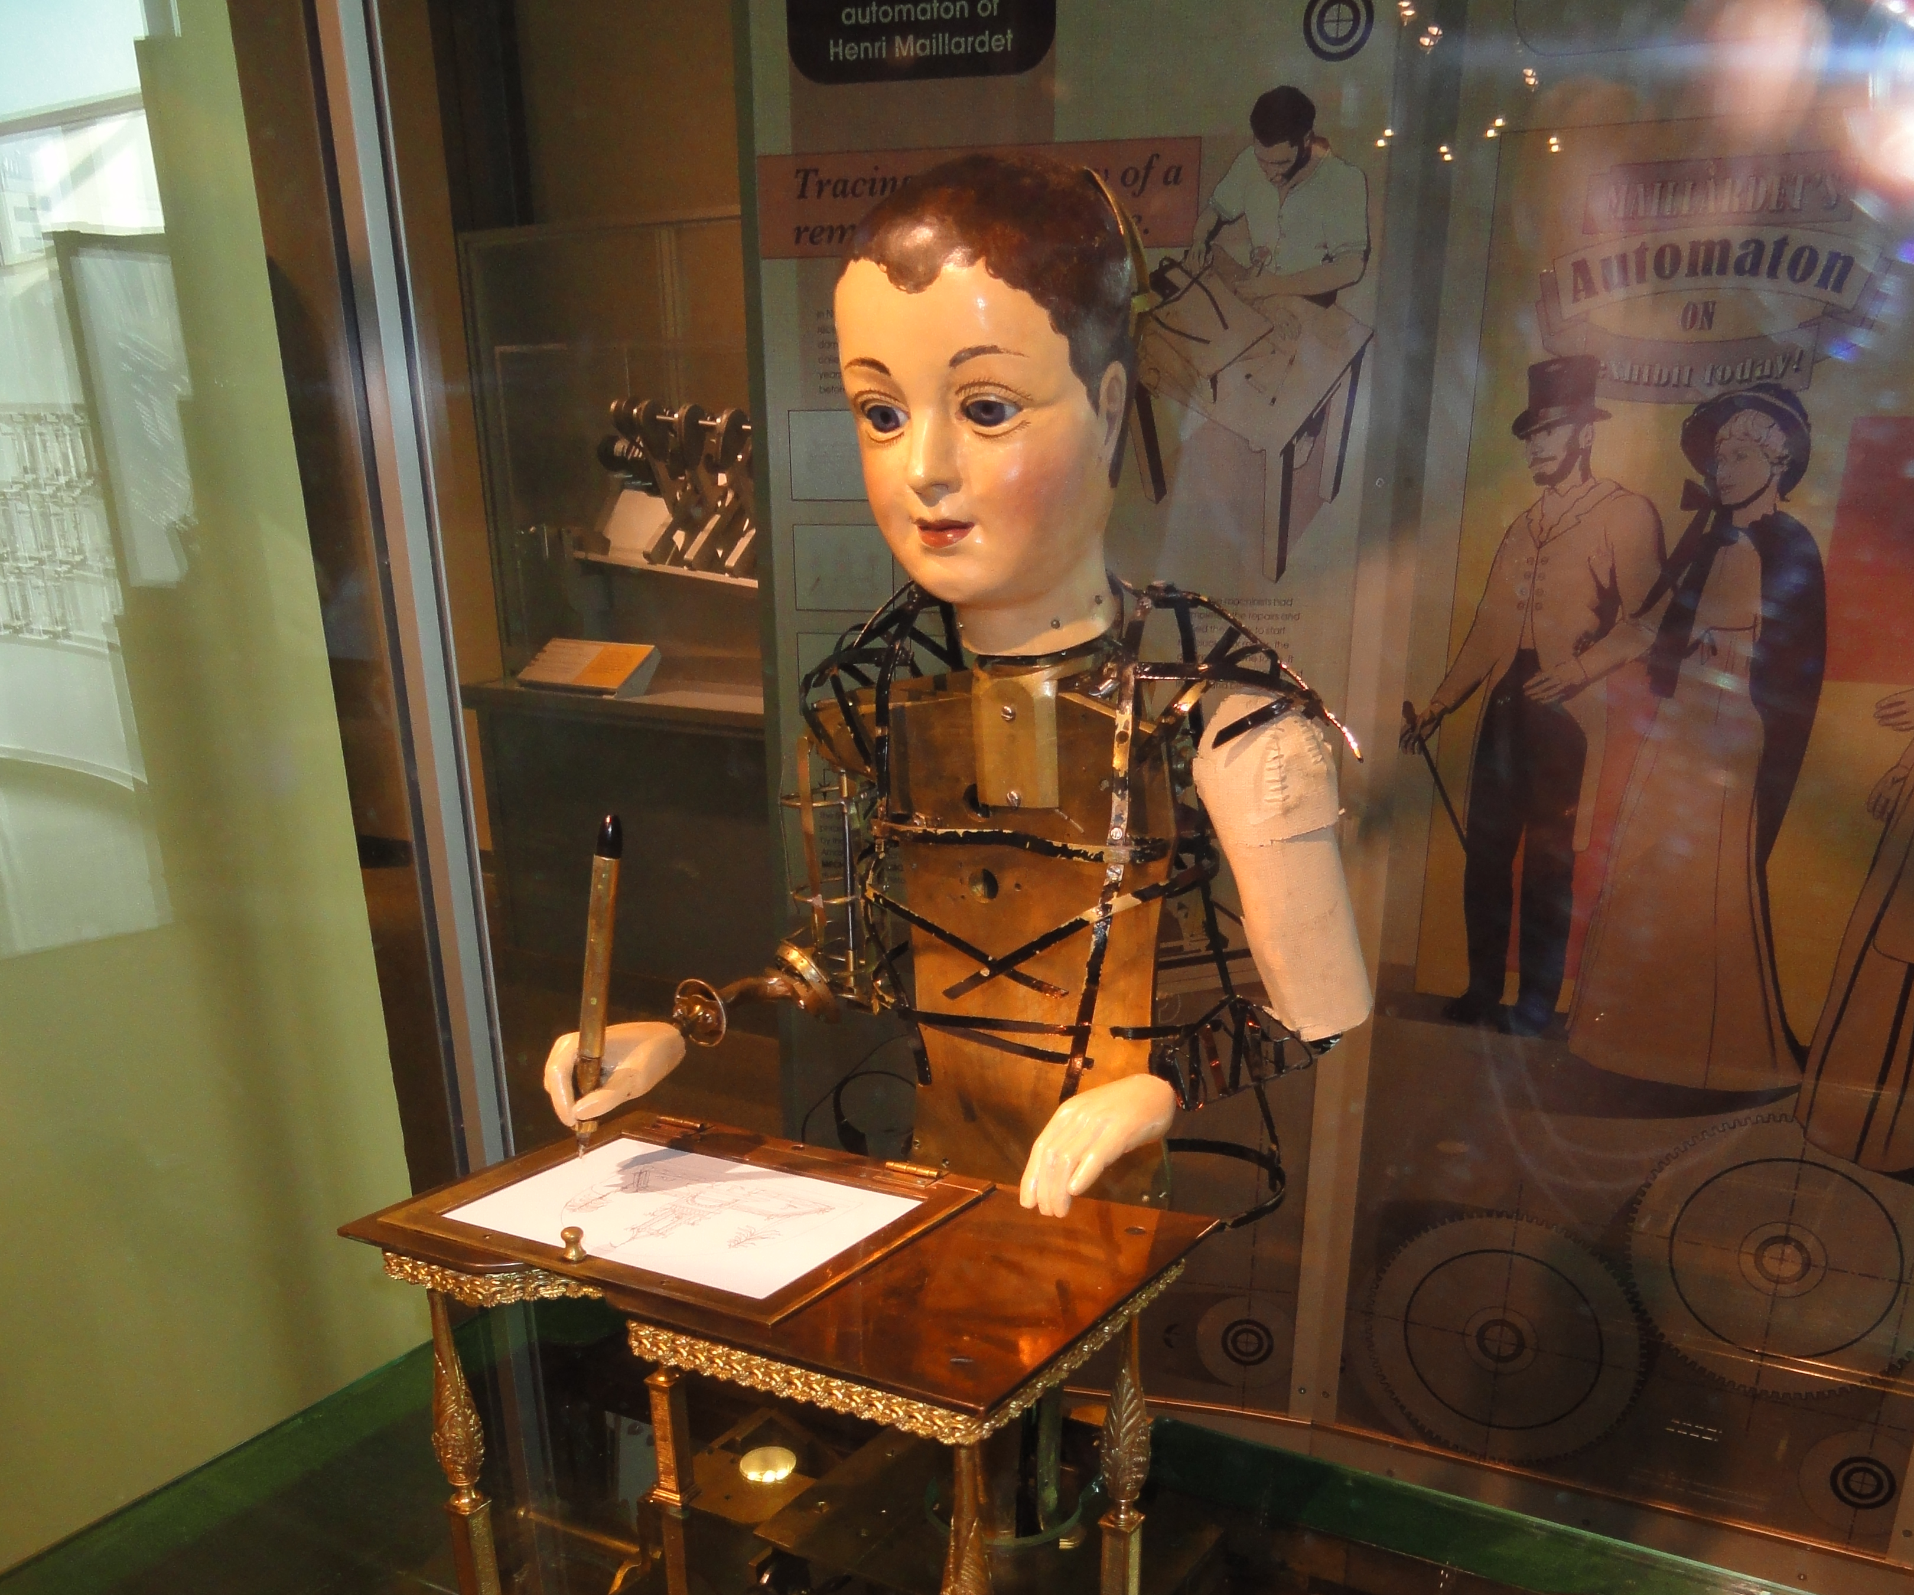
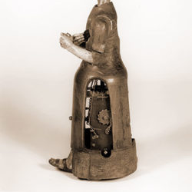
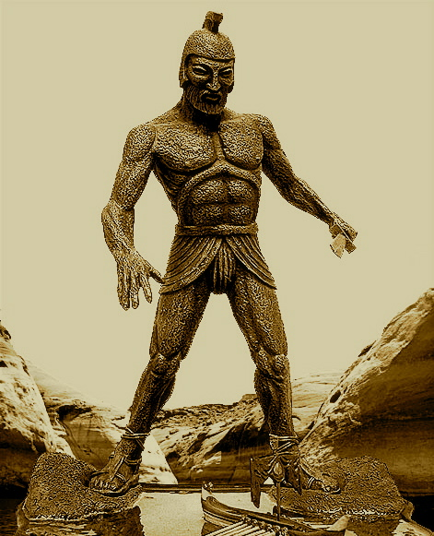
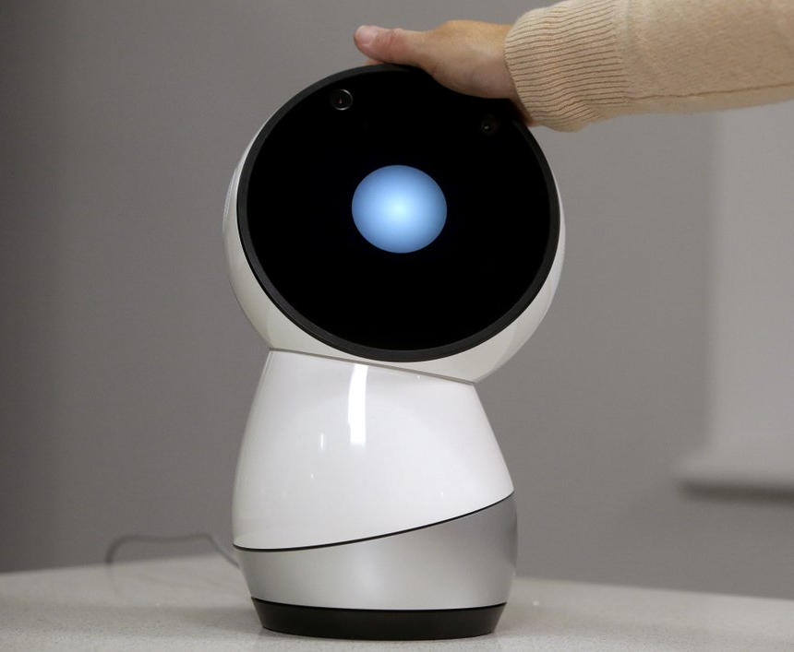
What is an Automaton?
A word of Greek origin first coined in the Iliad to refer to automated mechanics, like an automatic door.
Commonly used to refer to robots that emulate biological life but can be used to describe automated mechanics of any kind.

Slide 4
Timeline of automata

Slide 5
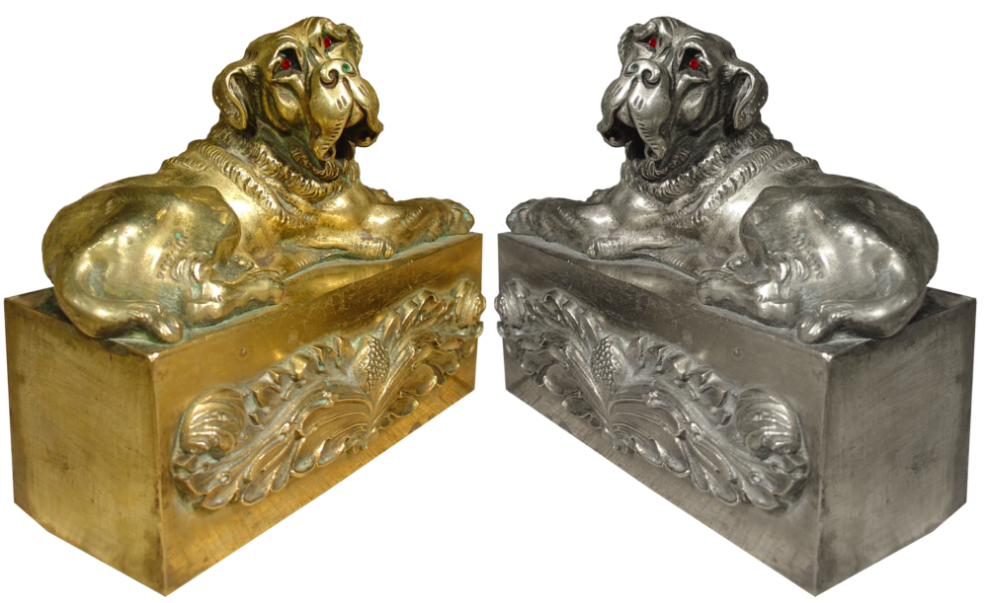
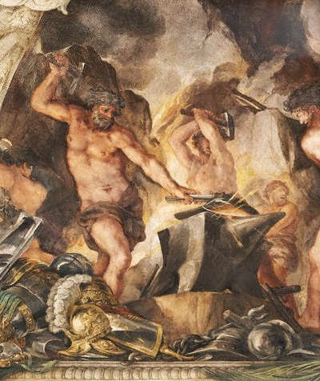
Ancient Greek mythology
Greek Mythology has had a large impact on culture even to this day. The Greeks’ fascination with automated mechanisms and emulating biological life started with mythology and tales of automated life.
Talos, copper giant
Giant copper automaton who looked like a human man guards the island of Crete
Mobile tripods
A bowl with 3 legs and 3 wheels, used during banquets of the Gods for distributing food and drink
Hephaestus’s automatons
Made automatons that worked in his workshop
The Guard Dogs of Alcinous
King Alcinous owned a gold and a silver automaton guard dog

Slide 6
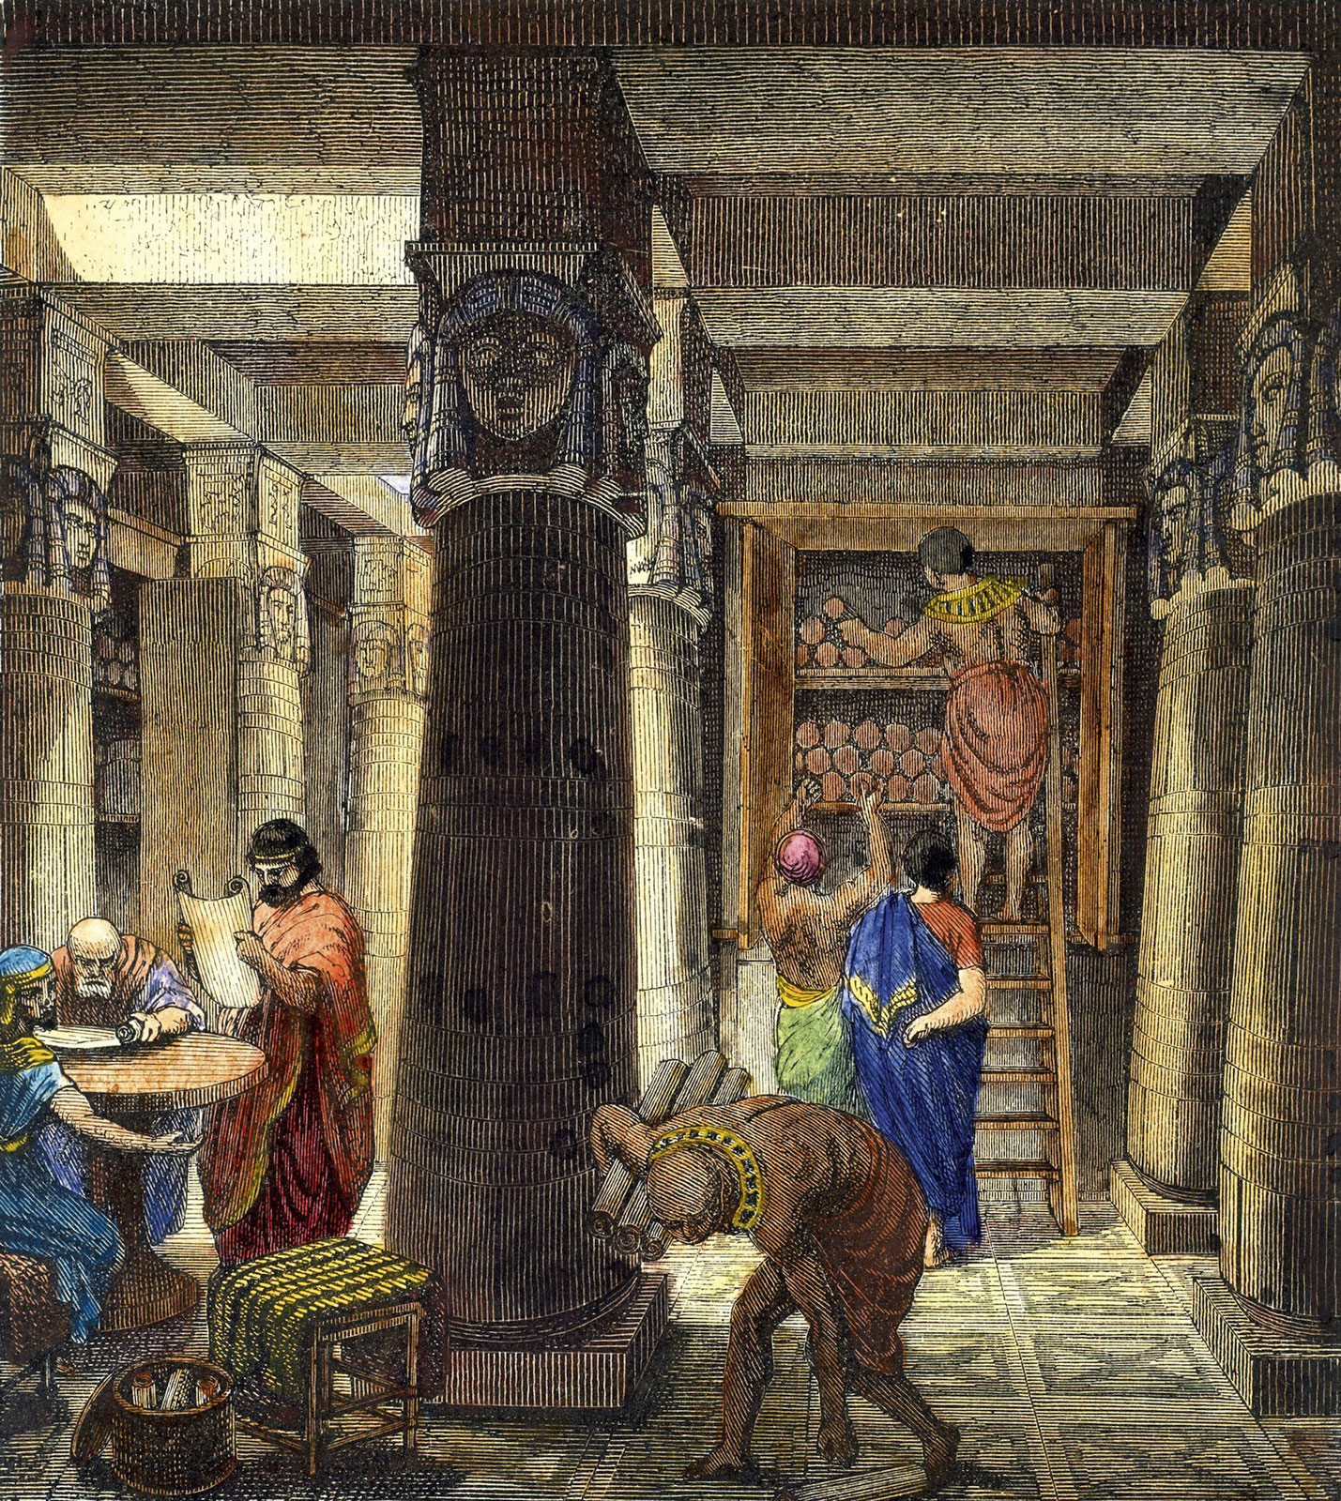
Alexandria
Alexandria, Egypt was the intellectual and cultural center of the ancient Mediterranean world, and had a strong engineering tradition
Most of the Greek engineers and scientists studied in the Great Library of Alexandria

Slide 7
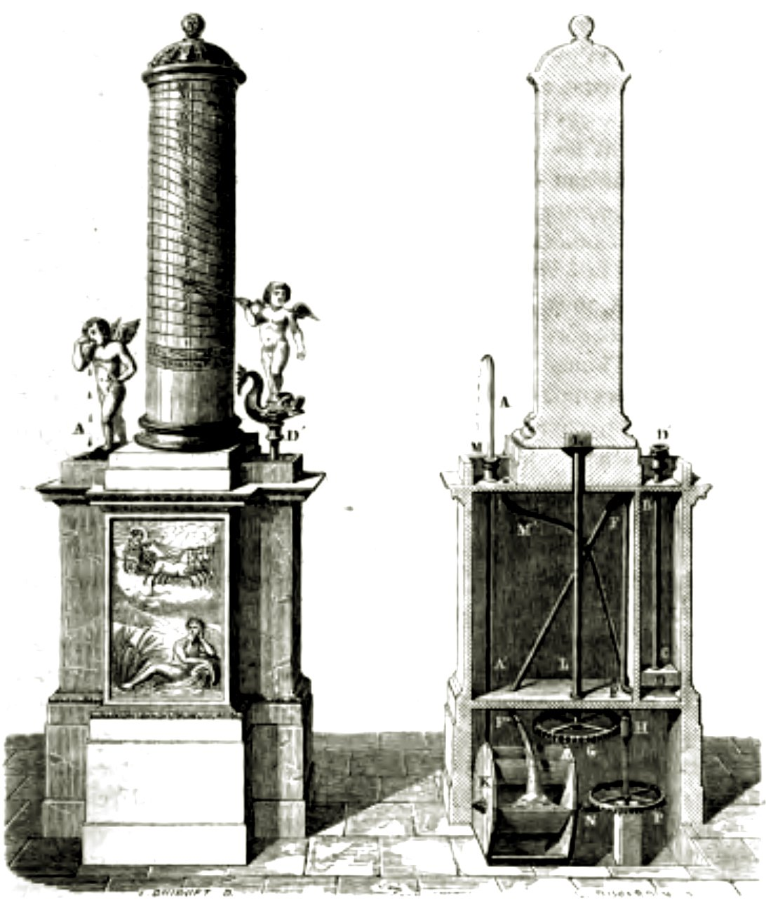
Ctesibius of Alexandria (270BC)
Was the first great Greek physicist and inventor in Alexandria, Egypt
Responsible for many inventions and discoveries, including the elasticity of air which he used in his inventions
Generally considered the inventor of the first cuckoo clock which had a bird automaton whistling. It worked by using water to force air through the bird’s mouth.

Slide 8
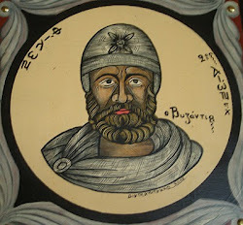
Philo of Byzantium (220 BC)
Philo was a Greek mechanical engineer who was the author of the Compendium of Mechanics
In this compendium is an entire section on toys and automata called “Automatopoeica” which describes several automata:
Automatic Theater: At the pull of a string, a show with moving figures and effects like lightning and fire
Puppet Carpenter: A simple automaton of a moving carpenter
Automatic Maid: A humanoid statue that dispensed wine when a cup is placed in its hand
Generally considered the first robot!

Slide 9
Automatic Maid video

Slide 10
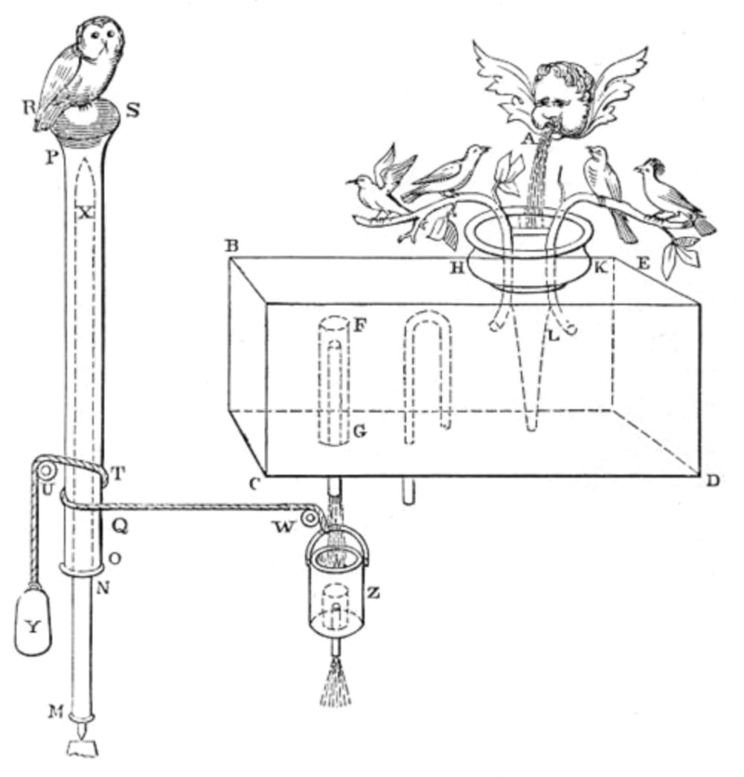
Hero of Alexandria (70 A.D.)
Hero of Alexandria was a Greek mathematician and engineer who had works inspired by Ctesibius and Philo
He invented the first steam engine (aeolipile) and the first machine that harvested wind power on land (windwheel)
Using these new ways of harnessing power, Hero created a few automata:
Wind-powered organ: The first wind powered machine, used a windmill to pump air into a pipe organ and play music
Automatic vending machine: A coin is inserted into the machine which slides down a lever. As it slides down, the other side released holy water until the coin fell down.
Hero’s Water Basin: Hero’s basin consisted of metal birds making noise until a mechanical owl turned toward them and silenced them. The birds chirped once more when the owl turned away.

Slide 11
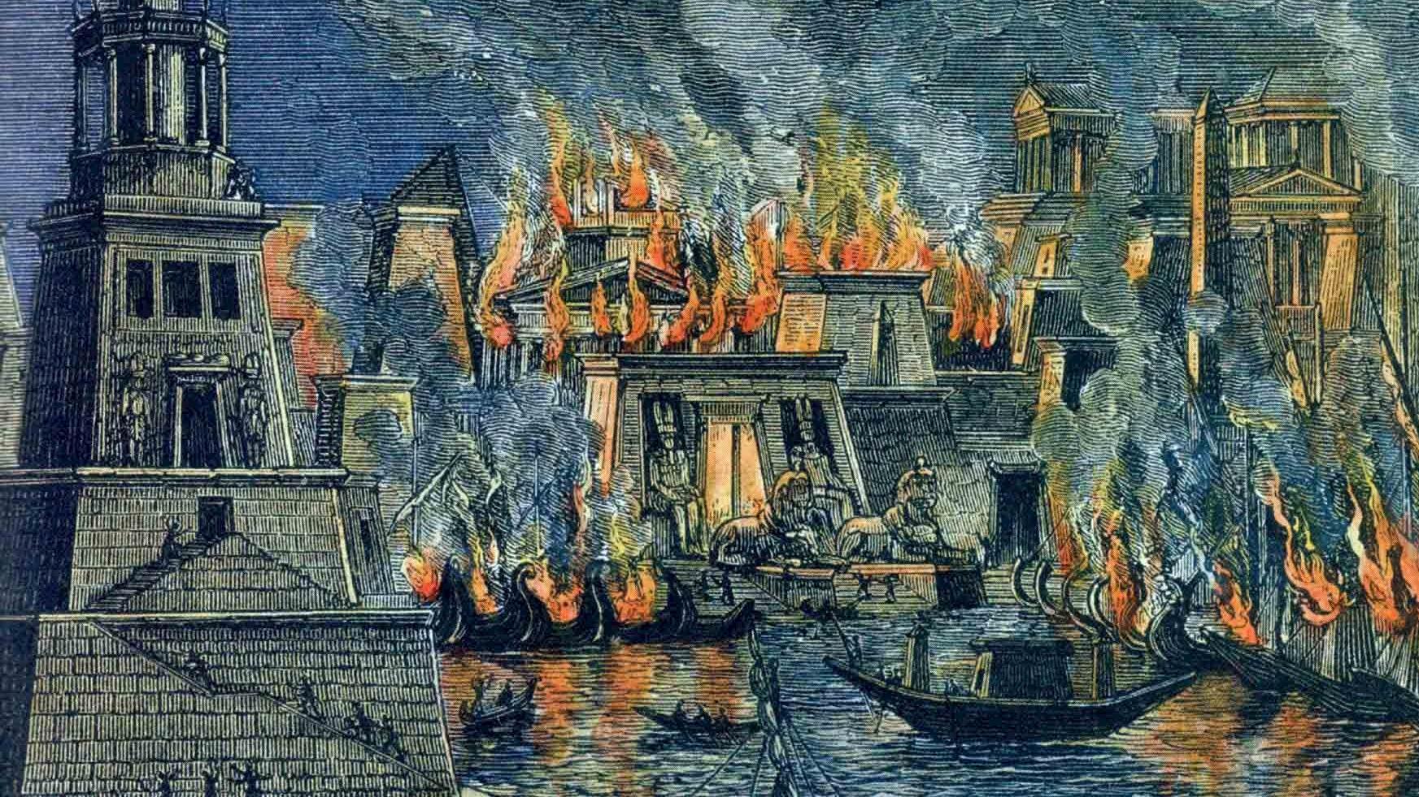
Decline into the dark ages
Since the fall of the Roman empire in 476 A.D., many people were illiterate in Europe, and the pursuit of knowledge had been extinguished in the region until about 1000 years later.
Progress did not stop, however, as the Islamic Golden Age produced amazing inventors who made automata!

Slide 12
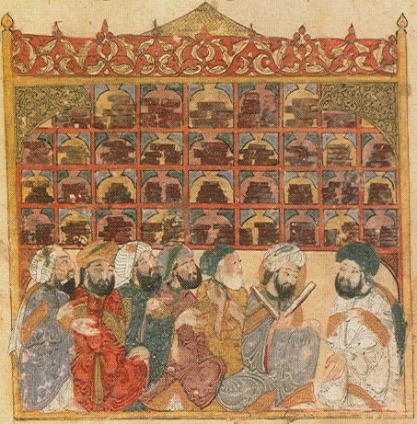
Islamic Golden Age 800 AD
The Islamic Golden Age started a few centuries after the fall of the Roman empire
Some of the Greek works were preserved in the House of Wisdom
The House of Wisdom was their Great Library of Alexandria and was located in Baghdad, the cultural center of the Muslim people
The main thing the Muslim people did was introduce practicality to automatons, mainly taking Greek inspired mechanisms and putting them to use.

Slide 13
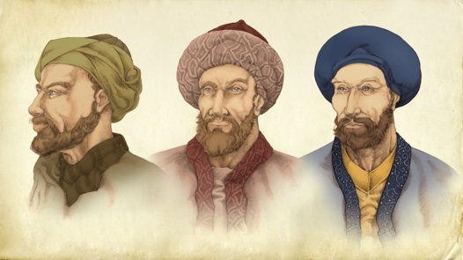
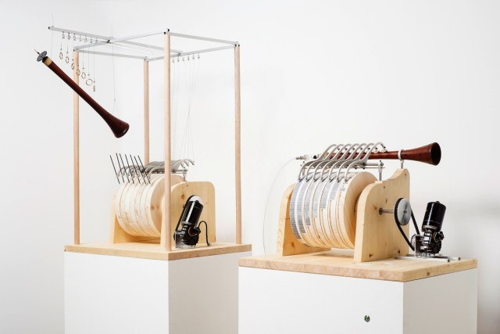
Banu Musa Brothers (9th Century)
The Banu Musa brothers were scholars in the House of Wisdom who published the Book of Ingenious Devices
Book of Ingenious Devices
Influenced by Greek works by Hero, Philon, and Ctesibius.
It included 100 new inventions including the first programmable machine
Automated Flute Player
The Automated Flute Player produced sounds through steam and the user could change the tones it made in various patterns, making it the first programmable machine.

Slide 14
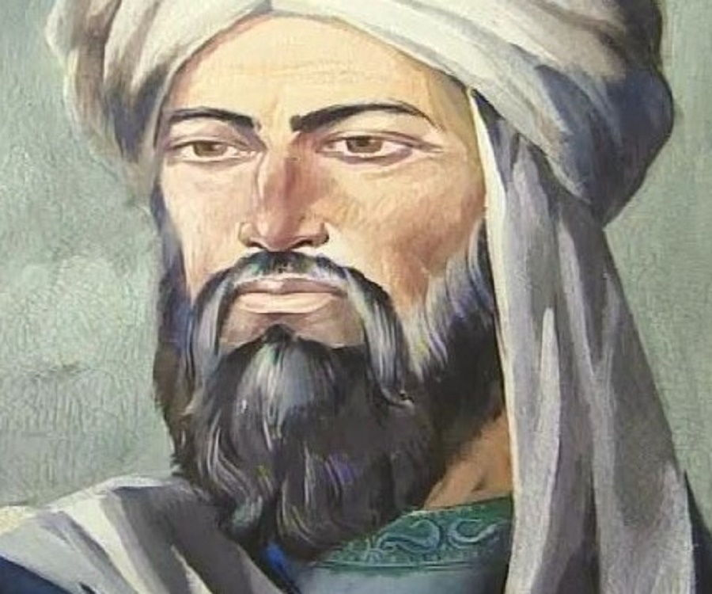
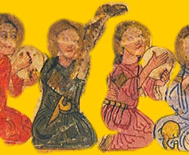
Ismail al-Jazari (1136-1206)
Ismail was a renaissance man before the renaissance. He also had a sense of humor, which is why he published a book of 100 inventions (most of which being trick vessels) called The Book of Knowledge of Ingenious Mechanical Devices.
Automaton Waitress: An automaton that served drinks, very akin to the work of Philo
Boat Orchestra: An automaton orchestra that floated on a boat, made to please guests.

Slide 15
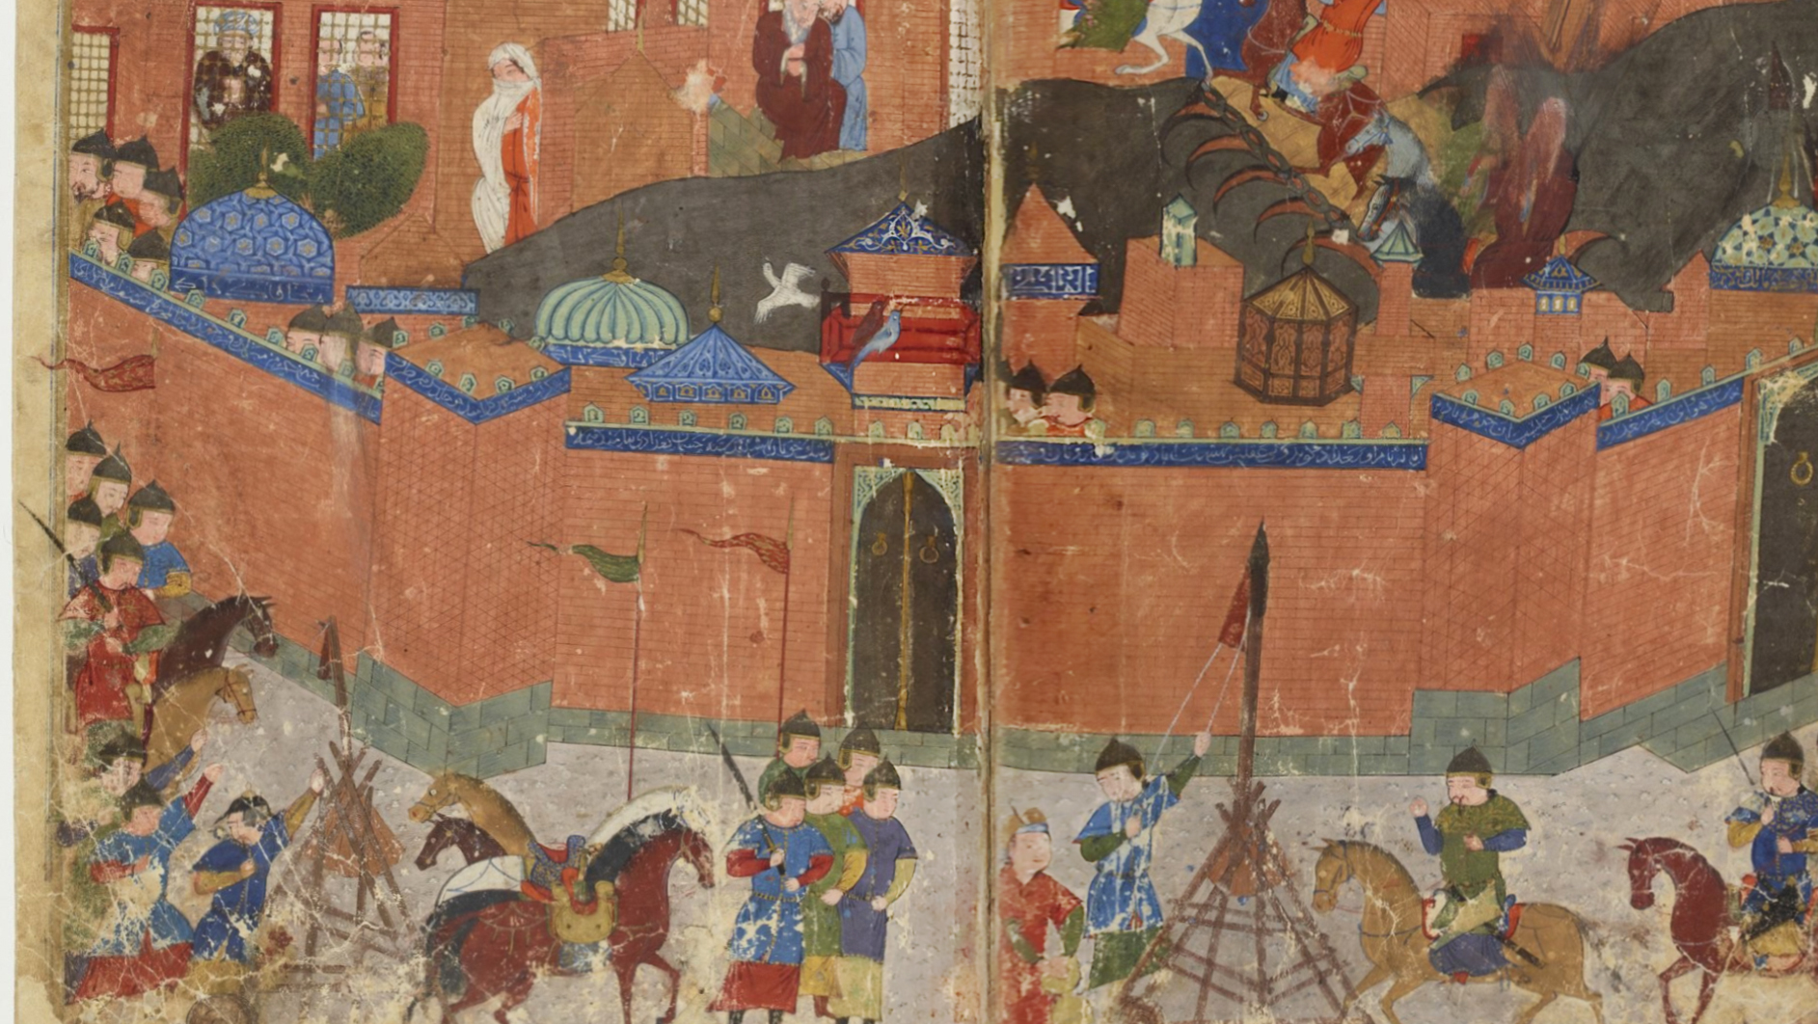
Decline of the Islamic Golden Age
The House of Wisdom was destroyed along with a lot of Baghdad during the Seige of Baghdad in 1258.
About a century later, the Renaissance would kick off in Europe and exploration of Automata would continue

Slide 16
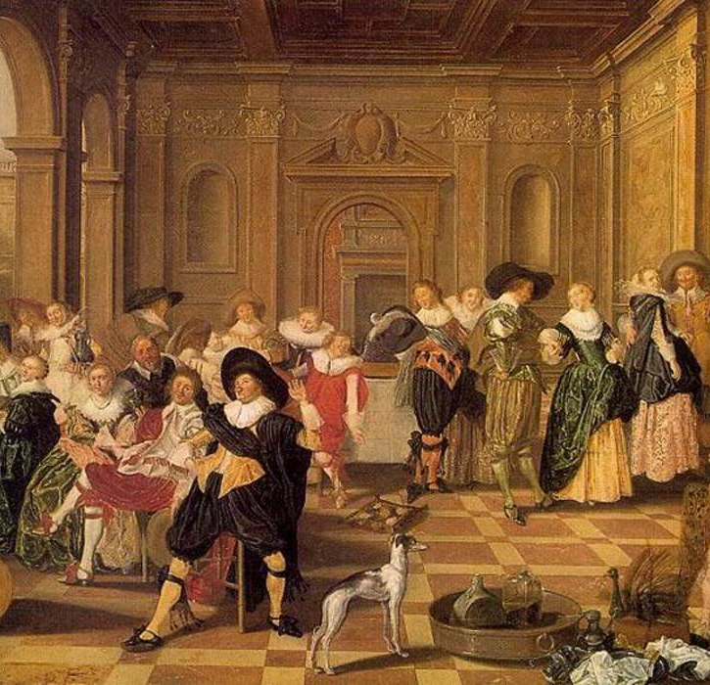
Modern Automata
During the Renaissance, the early stages of the Scientific Revolution began due to the printing press and literacy rates going up again.
Ctesibius, Philon, and Hero’s works were translated into Latin and were available to scholars all over the world
During this period, automata were made for amusement and to show off the ability of watchmakers and engineers

Slide 17
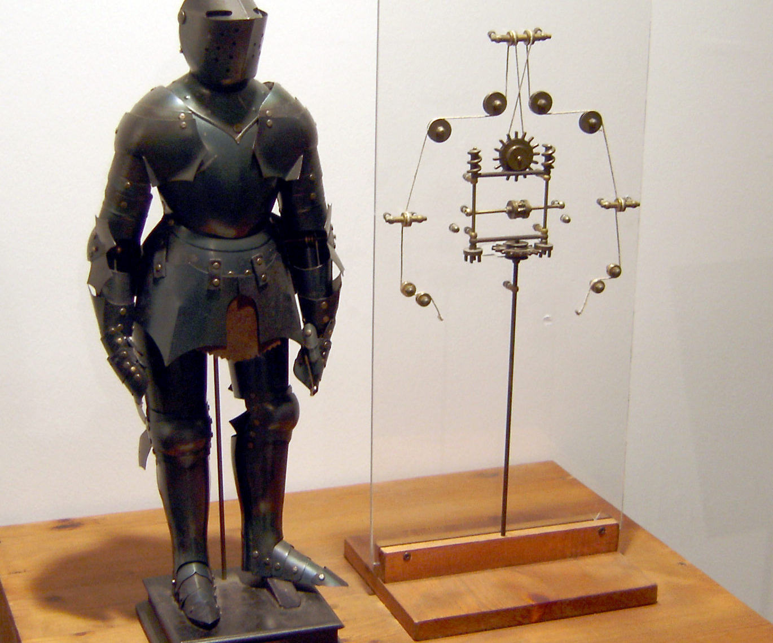
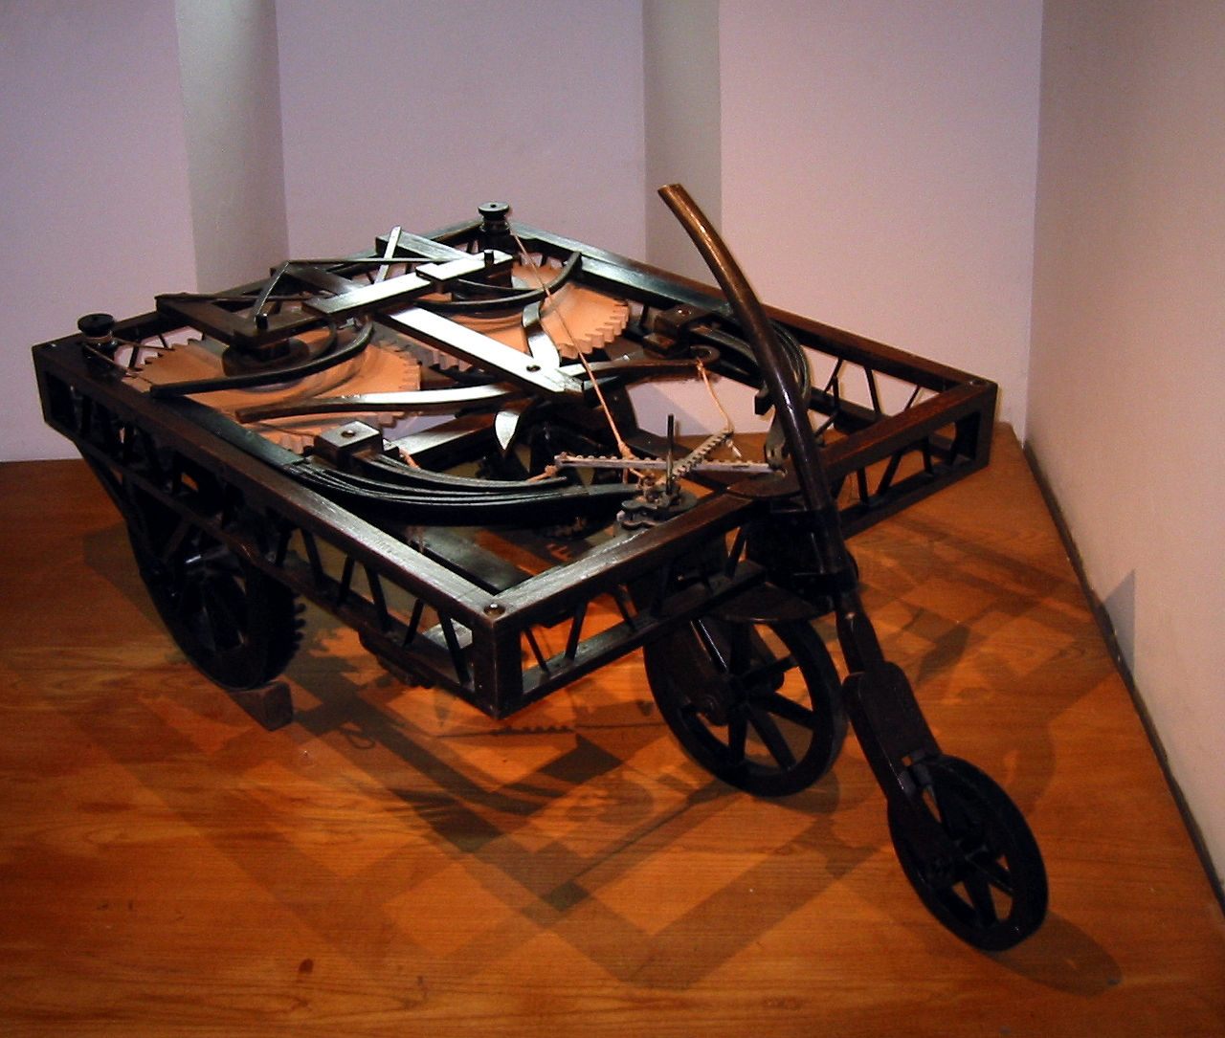
Leonardo da vinci
Leonardo’s anatomic research as depicted in the Vitruvian Man inspired him to create a robot of his own, later called Leonardo’s Robot.
This robot was able to stand, sit, raise its visor and move its arms all in human-like fashion
Leonardo also made an ancestor of the car known as the self-propelled cart.
This cart was able to move on its own using two clockwork springs and was able to be programmed to use a specific path

Slide 18
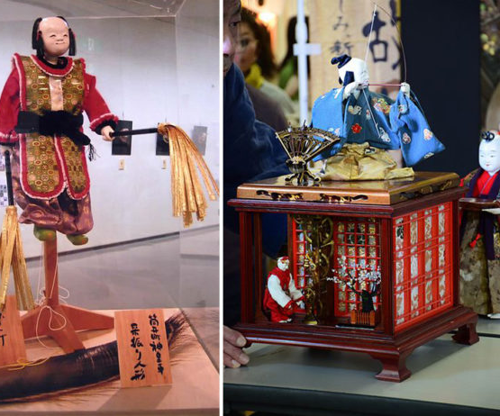
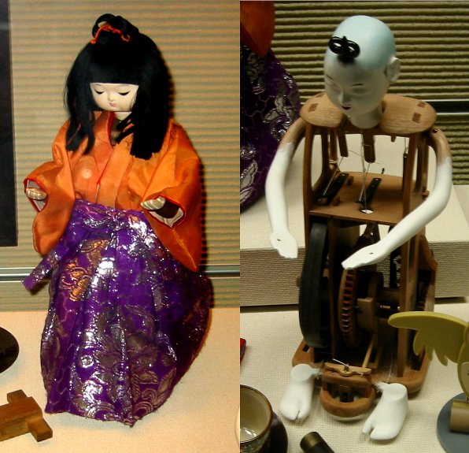
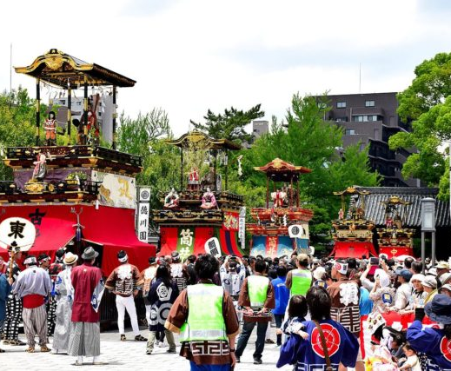
Karakuri
Karakuri are Japanese automata designed between the 1600’s and 1800’s and mainly came in 3 types
Butai Karakuri were life sized puppets mainly used for theater
Zashiki Karakuri were smaller automata used in the home
Dashi Karakuri were used in festivals and religious eventsa
These automata were mainly involved in entertainment

Slide 19
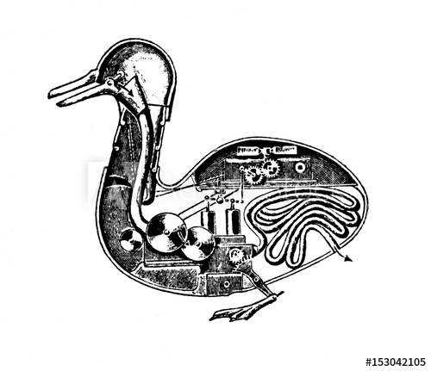
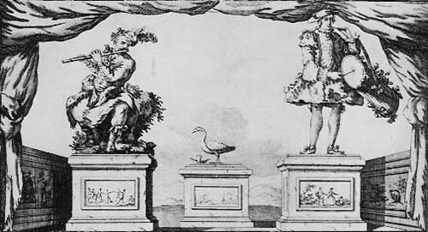
Jacques de Vaucanson
Possibly the height of automata was the works of Jacques de Vaucanson. He fine-tuned human-like motion and introduced biological functions like digesting to his automata.
Flute Player: This lifelike flute player was revolutionary. It had skin, could breathe against the flute, and play 12 songs
Digesting Duck: This automata was a duck that was able to eat food from your hand and defecate using a hidden compartment

Slide 20
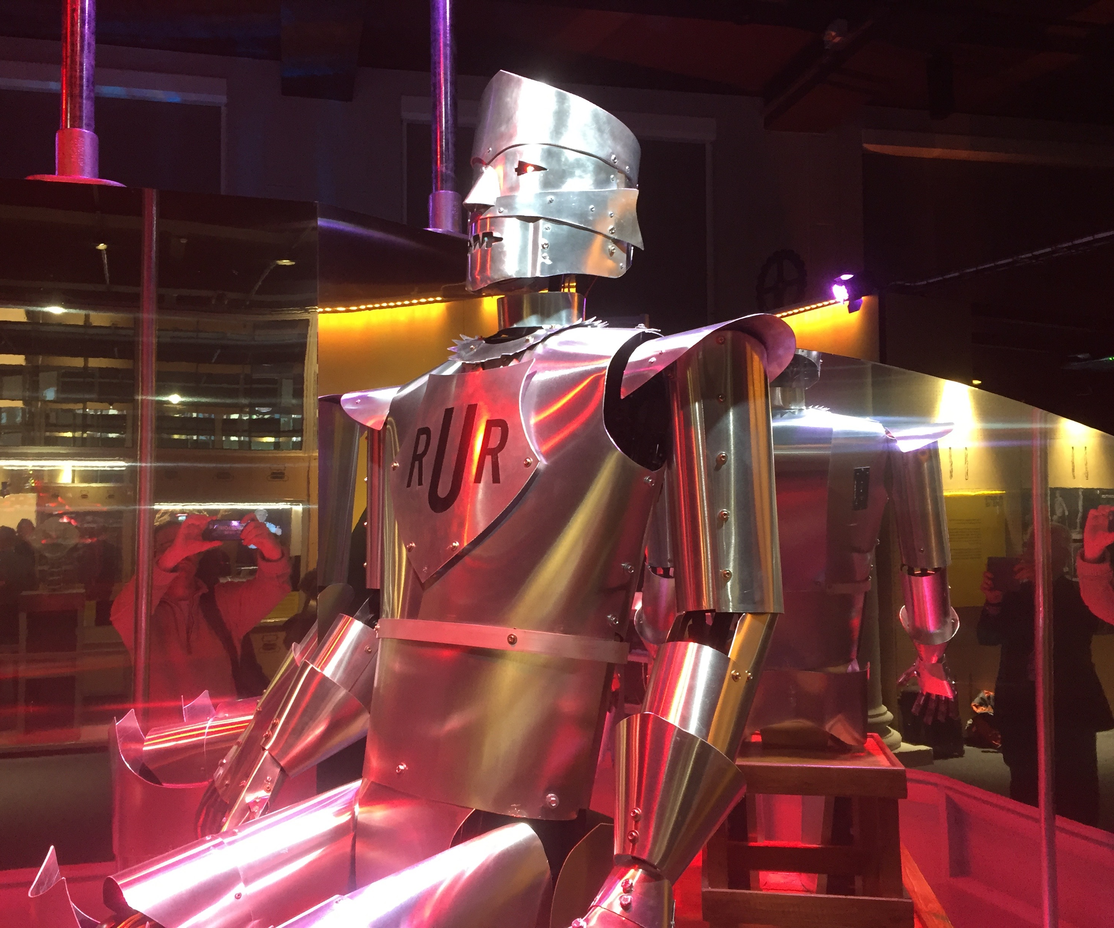
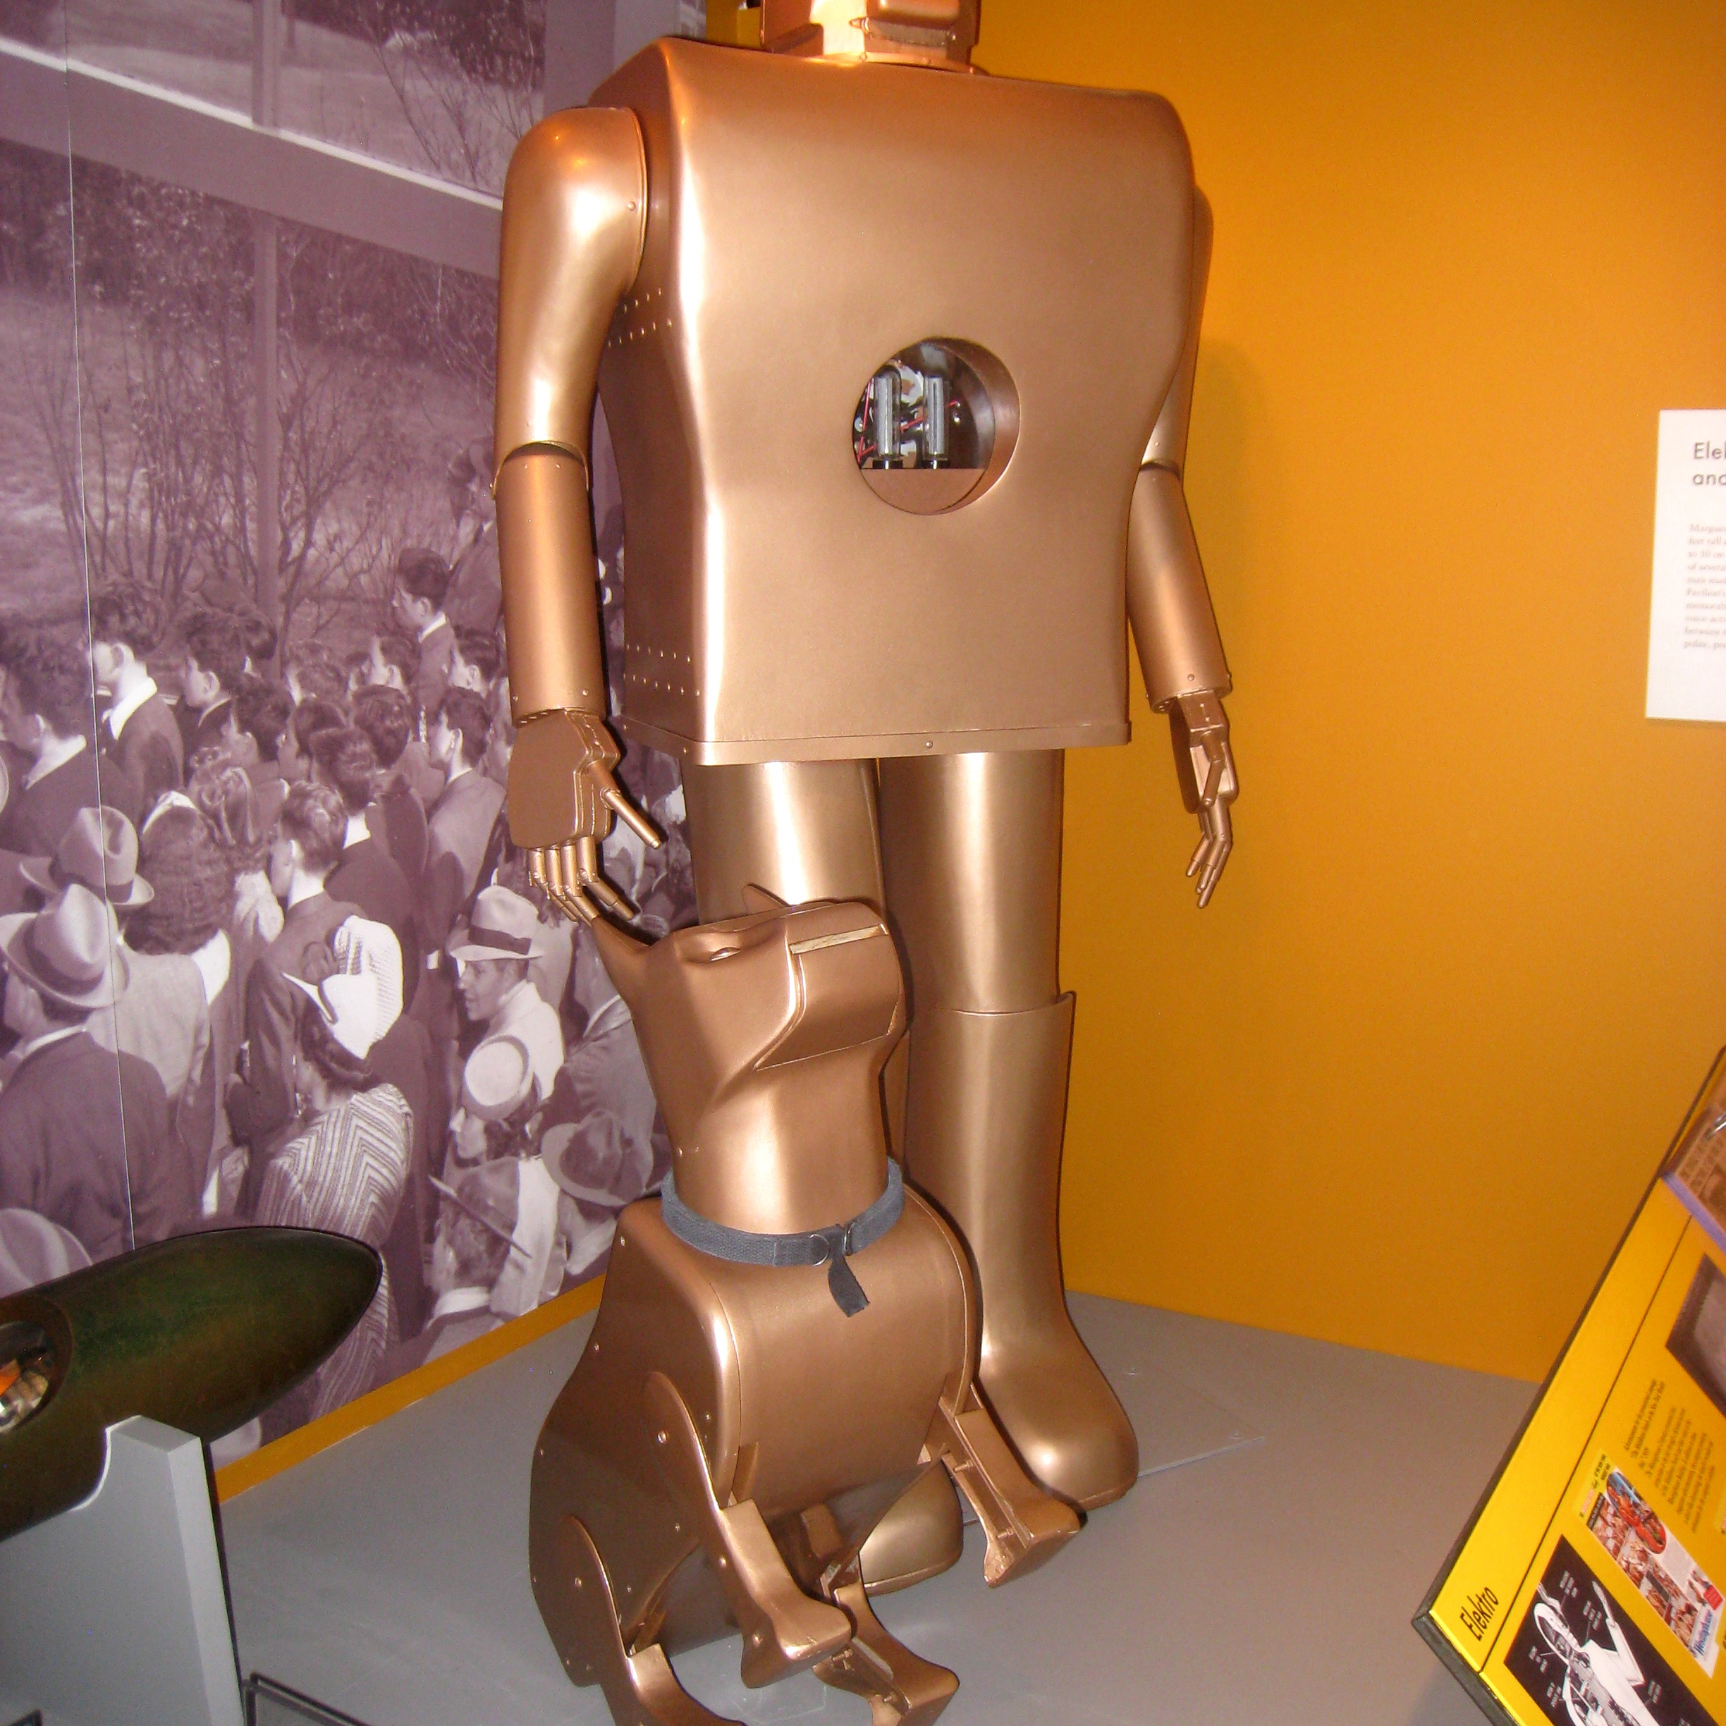
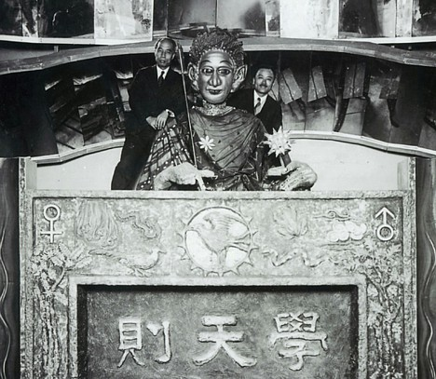
Robots
Early digital robots as we know them today appeared in the 1920’s and 30’s
The marketing for them veered more on being “the perfect man” but were far from replacing humans.
Eric
One of the first humanoid robots, could move its hands and head, as well as be remote controlled
Electro
A robot by Westinghouse, was given a lot of tasks including movement, blowing up balloons, and even smoking!
Gakutensoku
The first Japanese robot, was made by a biologist Makoto Nishimura and could show different expressions

Slide 21
Electro

Slide 22
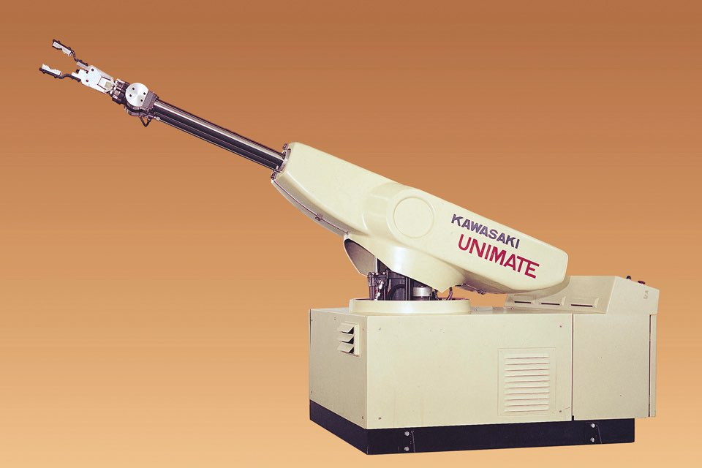
Autonomy
As robots continued to advance, more work was done to make them self-sufficient and autonomous.
Elmer and Elsie
Made by a neurobiologist, these robots were the first to be made to think like humans do (using hardware sensors). They can avoid obstacles as they chase light and even know they’re low on battery and need to charge.
Unimate
The first digitally operated and programable robot, used for industrial purposes

Slide 23
Elmer and Elsie, very slow autonomous robots

Slide 24
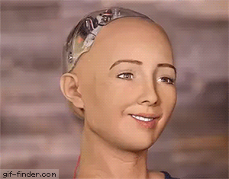
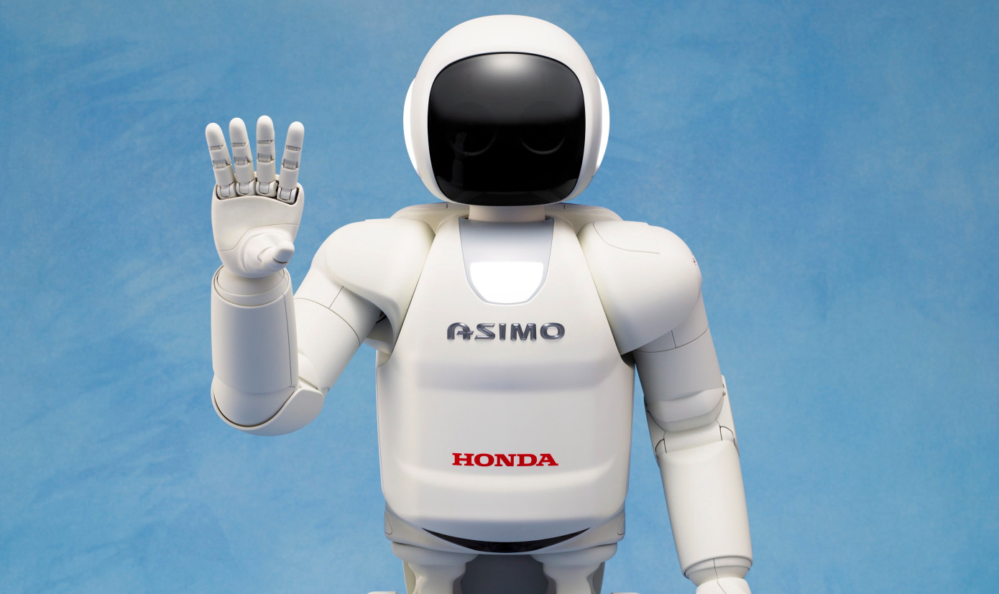
Modern robots
Modern robots are much more sophisticated and intelligent thanks to advances in AI and sensors
Asimo
A famous robot made by Honda in 2000
Atlas
A robot made by Boston Dynamics in 2013 mainly for search and rescue, but has demonstrated many advanced abilities like doing parkour
Sophia
A robot made by Hanson Robotics in 2016 and has many advanced capabilities such as making over 60 facial expressions, communication, and even is the first robot to earn citizenship in a country (Saudi Arabia)

Slide 25
What next?
With many advancements in AI on the software side and sensor technology, we are likely to see more believable human-like robots. We’re already in the uncanny valley with Sophia.

Slide 26
Sources
https://www.amazon.com/How-Smart-Machines-Think-Press/dp/0262038404
https://link.springer.com/chapter/10.1007/978-1-4020-8784-4_5
https://www.greeklegendsandmyths.com/automatons.html
https://journals.sagepub.com/doi/pdf/10.1177/002029400303600302
https://www.britannica.com/biography/Ctesibius-of-Alexandria
https://www.academia.edu/3839329/Philo_of_Byzantium_in_R.S._BAGNALL_et_al._edd._The_Encyclopedia_of_Ancient_History_Chichester_Malden_MA_2013_5266-8

Slide 27
https://books.google.com/books?id=7GwosjyB8ncC&pg=PA206&lpg=PA206&dq=Automatopoeica&source=bl&ots=CP9hzKN6De&sig=ACfU3U1H_RcgSpqCP4o4CGJ1KHXfX9AKig&hl=en&sa=X&ved=2ahUKEwjCjKnsmejnAhVNVd8KHfKpBocQ6AEwAnoECAkQAQ#v=onepage&q=Automatopoeica&f=false
https://www.nndb.com/people/898/000103589/
https://themadmuseum.co.uk/history-of-automata/
https://www.ancient.eu/article/207/what-happened-to-the-great-library-at-alexandria/
https://muslimheritage.com/the-mechanics-of-banu-musa-in-the-light-of-modern-system-and-control-engineering/
https://www.britannica.com/technology/automaton#ref284645
https://history-computer.com/Dreamers/LeonardoAutomata.html

Slide 28
https://www.youtube.com/watch?v=-OKxrA683NU
https://5wvelascoblog.com/2016/11/15/the-800-year-old-cutaway-graphics-of-ismail-al-jazari/
https://www.youtube.com/watch?v=Sq36J9pNaEo

